Slide 1


Department of Computer Science and Engineering
CS19643 FOUNDATIONS OF MACHINE LEARNING
ANALYZING SELLING PROCE OF USED CARS
Dr.S. Vinodkumar
Professor
P ARVIND
210701034
S KESARIKUMARAN
210701324

Slide 2
Abstract
The project is to develop a robust machine learning model for accurately predicting the selling price of used cars, addressing the complex and multifaceted factors influencing car prices. The objectives encompass comprehensive data collection, meticulous preprocessing, insightful exploratory data analysis, rigorous model development, thorough evaluation, and practical deployment. By achieving these objectives, the project aims to provide valuable insights into the used car market, empower businesses with effective pricing strategies, enhance customer satisfaction, and exemplify the transformative potential of machine learning in optimizing operations within the automotive industry.

Slide 3
Existing System
This project focuses on analyzing the selling price of used cars using Python, employing machine learning algorithms to predict prices based on historical data. The success of these models hinges on thorough data analysis, which involves cleaning, organizing, and preprocessing the dataset to ensure it is suitable for training.Model evaluation metrics, including mean absolute error and root mean square error, will be used to assess the performance of the models and ensure their accuracy. By continuously refining the models through techniques like cross-validation and hyperparameter tuning, the project aims to achieve the highest possible predictive accuracy. Ultimately, this comprehensive approach underscores the transformative potential of machine learning in making data-driven decisions and optimizing operations within the used car marke

Slide 4
Proposed System
In the rapidly growing used car market, accurately determining car prices is critical for both consumers and businesses. The complexity arises from the myriad of factors influencing car prices, such as the vehicle's make and model, age, mileage, condition, location, and prevailing market trends. Developing a predictive model that can effectively capture and analyse these diverse variables is essential for generating reliable price estimates. The core issue lies in ensuring the model's accuracy and robustness, which necessitates meticulous data 11 collection, preprocessing, and analysis to handle real-world data's inherent inconsistencies and variations. Addressing this problem not only aids in making informed business decisions and enhancing sales strategies but also improves customer satisfaction by providing transparent and accurate pricing information.

Slide 5
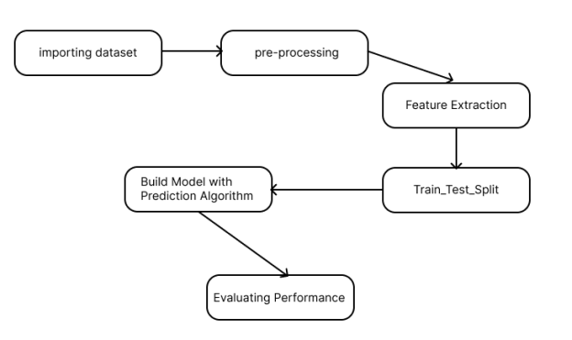
System Architecture
Android wi camera or VR

Slide 6
List of Modules
Extracting the data and its format
Data Analysis
Creating Machine Learning Model for Analysis
User Experience

Slide 7
Functional Description for each modules
EXTRACTING THE DATA AND ITS FORMAT:The data extraction process begins with importing necessary libraries such as Pandas for data manipulation, NumPy for numerical operations, Matplotlib and Seaborn for data visualization, and SciPy for scientific computing. The dataset, stored in a CSV file named 'output.csv', is then read into a Pandas DataFrame using the `read_csv()` function. Upon loading the dataset, the first five entries are displayed to provide an initial overview of the data's structure and content. Subsequently, the column headers are defined to ensure clarity and consistency in data representation. Any missing or null values within the dataset are identified using the `isna().any()` and `isnull().any()` functions, allowing for appropriate handling or imputation of missing data points. In this instance, any rows containing missing price values marked as '?' are removed from the dataset to maintain data integrity.

Slide 8
Functional Description of Module
DATA ANALYSIS: The data analysis phase begins with a comprehensive exploration of the dataset's characteristics to gain insights into the relationships and patterns within the data. This involves visualizing key features and examining their distributions, correlations, and dependencies. Techniques such as histograms, scatter plots, and correlation matrices are employed to visualize the relationships between variables and identify any potential trends or outliers. For instance, histograms provide a graphical representation of the distribution of numerical attributes, allowing for the identification of skewed or abnormal data distributions, while scatter plots reveal the relationship between two continuous variables, aiding in the identification of potential correlations or associations.

Slide 9
Functional Description of Module
CREATING MACHINE LEARNING MODEL FOR ANALYSIS: In the creation of machine learning models for analysis, several algorithms are explored and evaluated to predict the selling price of used cars accurately. The dataset, having undergone preprocessing and exploratory data analysis, is divided into training and testing sets to facilitate model development and evaluation. Various machine learning algorithms, including linear regression, decision trees, random forests, and gradient boosting, are considered to determine the most effective 25 approach for predicting car prices. Each algorithm is implemented and trained on the training data, with model parameters optimized to maximize predictive performance.

Slide 10
Functional Description of Module
USER EXPERIENCE: In the user experience aspect of the project, the focus is on providing stakeholders with an intuitive and informative interface for interacting with the predictive model and accessing insights derived from the analysis of used car prices. The user interface is designed to be userfriendly, visually appealing, and accessible across different devices and platforms. Key functionalities include data visualization tools, interactive dashboards, and real-time prediction capabilities, aimed at empowering users to make informed decisions regarding car pricing strategies. Data visualization plays a crucial role in enhancing user understanding and engagement with the predictive model. Interactive charts, graphs, and plots are utilized to visualize key insights and trends derived from the analysis of historical car sales data.

Slide 11
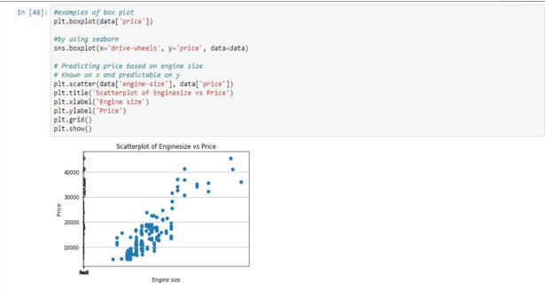
FINAL OUTPUT
Plotting the data according to the price based on engine size

Slide 12
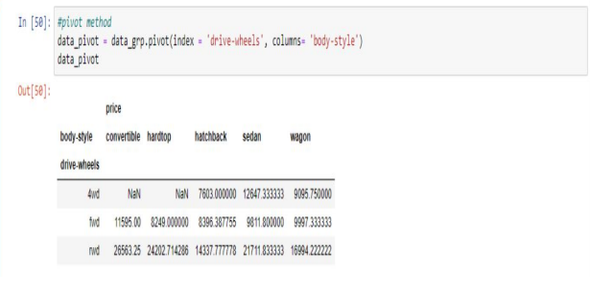
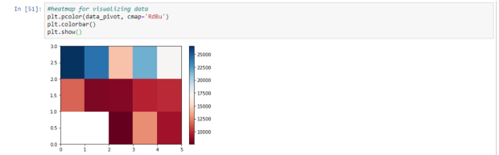
FINAL OUTPUT

Slide 13
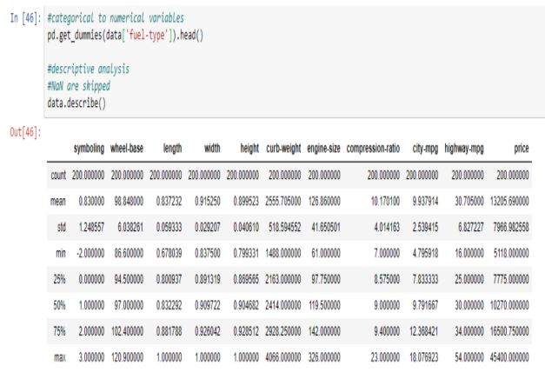
Implementation of Phase II

Slide 14
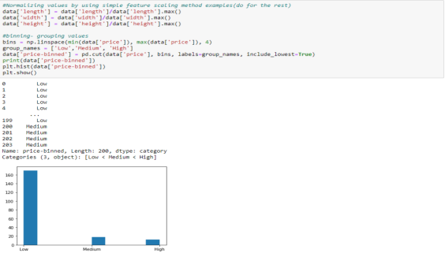
Implementation of Phase II

Slide 15
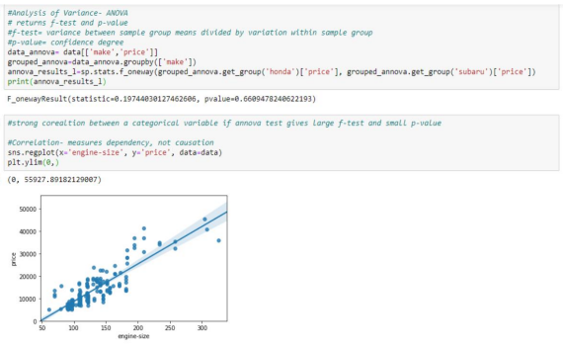
Implementation of Phase II

Slide 16
Conclusion
In conclusion, the analysis of selling prices of used cars presents valuable insights into the factors influencing pricing dynamics within the automotive market. Leveraging machine learning algorithms and comprehensive data preprocessing techniques, this project aimed to develop predictive models capable of accurately estimating car prices based on various attributes., normalize numerical features, and encode categorical variables, we ensured the data was appropriately modeling tasks. Through the implementation and evaluation of various machine learning algorithms, including linear regression, decision trees ,root mean square error (RMSE), and Rsquared (R2) score provided insights into the accuracy and reliability of the models. Additionally, visualizations such as scatter plots and regression plots facilitated the interpretation of model predictions and identified potential trends or patterns in the data

Slide 17
References
Flask Framework for Python Developer (Book)
Data Analytics Using Python (Book)
Data Visualization Using Python (Book)
Kaggle - https://www.kaggle.com/
UCI Machine Learning Repository - https://archive.ics.uci.edu/
AutoScout24 - https://www.autoscout24.com/
TrueCar - https://www.truecar.com/
Edmunds - https://www.edmunds.com/
Cargurus - https://www.cargurus.com

Slide 18
References
9.Chen, Chien-Wen & Chen, Wen-Zheng & Peng, Jain-Wei & Cheng, Bo-Xun & Pan, Tse-Yu & Kuo, Hsu-Chan. (2017). A Real-Time Markerless Augmented Reality Framework Based on SLAM Technique. 127-132. 10.1109/ISPAN-FCST-ISCC.2017.87.
10.Y Kaneto and T. Komuro, "Space-sharing AR interaction on multiple mobile devices with a depth camera," 2016 IEEE Virtual Reality (VR), Greenville, SC, USA, 2016, pp. 197-198, doi: 10.1109/VR.2016.7504721.
11.Xiao, Cheng & Lifeng, Zhang. (2014). Implementation of mobile augmented reality based on Vuforia and Rawajali. Proceedings of the IEEE International Conference on Software Engineering and Service Sciences, ICSESS. 912-915. 10.1109/ICSESS.2014.6933713.
12.Gabajová, Gabriela & Krajčovič, Martin & Matys, Marián & Furmannová, Beáta & Burganova, Natalia. (2021). DESIGNING VIRTUAL WORKPLACE USING UNITY 3D GAME ENGINE. Acta Tecnología. 7. 35-39. 10.22306/atec.v7i1.101.

Slide 19
Thank You

